Slide 1
MIS547
Cloud Computing

Slide 2
Lecture 23: LLMOps

Slide 3
Recall from Last Lecture…
Decoder-only
Pre-trained on language modeling task
Target sequence for decoder is simply a shifted version of the input sequence
“the cat sat on” → “the”
“the cat sat on the” → “mat”
Encoder-only
E.g., BERT
Pre-trained by corrupting the input sequence and having the model try to reconstruct it.
Masked language model (MLM):
“The [MASK] sat on the mat” → “The cat sat on the mat”
Encoder-decoder
Trained on sequence-to-sequence supervised tasks
Translation
”Le chat est assis sur le tapis” →
Question answering:
Summarization
“The cat sat on the mat”
Encoders & decoders
Decoder-only architectures
Encoder-only architectures
Encoder-decoder architectures
Notes:
61

Slide 4
Recall from last lecture…
Fine tuning language models:
Instruction-tuning/ instruction-following
LLM is provided as input an instruction to follow which might include summarizing text, writing code, writing a poem
Dialogue-tuning
LLM is fine-tuned on conversational data in the form of questions and responses (multi-turn dialogue)
Safety tuning
mitigates risks from bias, discrimination, toxic outputs
Reinforcement learning with human feedback

Slide 5
Recall from last lecture…
Prompt engineering:
Few-shot prompting
Zero-shot prompting
Chain-of-thought prompting
Sampling techniques:
Greedy search
Random sampling
Temperature sampling
Top-K sampling
Top-P sampling
Best-of-N sampling

Slide 6
Recall from last lecture:
Quality vs Latency/Cost Tradeoff
Latency vs. Cost Tradeoff (Latency vs. Throughput tradeoff)

Slide 7
Recall from last lecture…
Retrieval Augmented Generation (RAG)
1. Retrieve relevant documents from a knowledge base
2. Use prompt expansion to generate an answer from those documents
Prompt expansion: a model retrieves relevant information from the database using a combination of semantic search and business rules and augments the original prompt with it

Slide 8
Recall from last lecture
Models vs Agents
Models | Agents
Knowledge limited to what is available in their training data | Knowledge is extended through the connection with external systems via tools
Single inference/ prediction based on the user query; no management of session history or continuous context | Managed session history allows for multi-turn inference/ prediction based on user queries and decisions made in the orchestration layer. A turn is defined as an interaction between the interacting system and the agent
No native tool implementation | Tools are natively implemented in agent architecture
No native logic layer implemented. Users form prompts as simple questions or use reasoning frameworks | Native cognitive architecture that uses reasoning frameworks like CoT, ReAct, or LangChain

Slide 9
Picking up from where we left off…

Slide 10
Process
User sends query to agent
Agent begins ReAct sequence
Agent provides prompt to model, ask for next ReAct steps and output:
Question: The input question from the user query, provided with the prompt
Thought: The model’s returned result
Action: The model’s decision on what action to take next ( for example, a tool choice)
Action input: The model’s decision on what inputs to provide to the tool
Observation: the result of the action/ action input sequence (This action could repeat N times)
Final answer: final answer to provide to the original user query

Slide 11
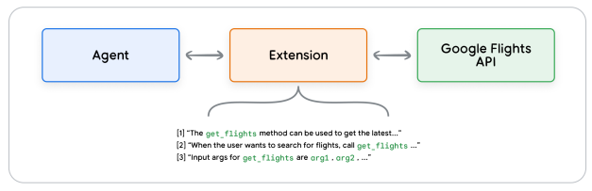
Extensions
Allow agents to execute APIs regardless of underlying implementation
Teach the agent how to use the API endpoint using examples
Teach the agent what arguments or parameters are needed to successfully call the API endpoint

Slide 12
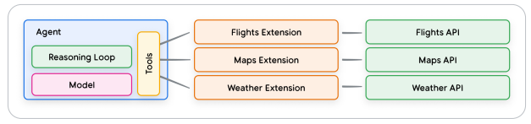
Extensions
The agent uses the model and examples at run time to decide which extension, if any, would be suitable for solving the user’s query.
Built-in example types allow the agent to dynamically select the most appropriate extension for the task

Slide 13
Functions
Functions: self-contained modules of code that accomplish a specific task and can be reused as needed
A model can take a set of known functions and decide when to use each function and what arguments the function needs based on its specification
Functions differ from extensions in that:
A model outputs a function and its arguments but doesn’t make a live API call
Functions are executed on the client-side, while extensions are executed on the agent-side

Slide 14
Functions
The logic and execution of calling the actual API endpoint is offloaded away from the agent and back to the client-side application.
Reasons to choose functions over extensions:
API calls need to be made at another layer of the application stack, outside the agent architecture flow
Security or authentication restrictions may prevent the agent from calling an API directly
Timing or order-of-operations constraints that prevent the agent from making API calls in real-time (i.e., batch operations, human-in-the-loop review, etc.)

Slide 15
Data stores
Provide access to more dynamic and up-to-date information, ensure a model’s responses remain grounded in factuality and relevance
Data store converts incoming document into a set of vector database embeddings that the agent can use to extract the information it needs to supplement its next action or response to the user.
Generally implemented as vector databases that the developer wants the agent to have access to at runtime.
Used extensively in RAG-based applications

Slide 16
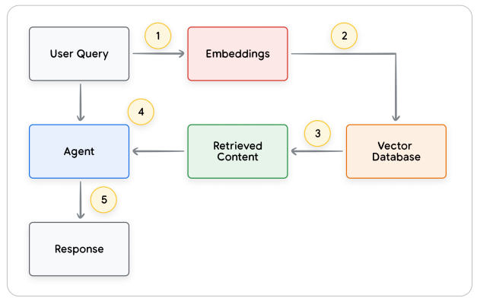
Data Stores
A user query is sent to an embedding model to generate embeddings for the query
The query embeddings are then matched against the contents of the vector database using a matching algorithm like SCaNN
The matched content is retrieved from the vector database in text format and sent back to the agent
The agent receives both the user query and retrieved content, then formulates a response or action
A final response is sent to the user

Slide 17
Tools recap
 | Extensions | Function Calling | Data Stores
Execution | Agent-side | Client-Side | Agent-Side
Use Cases | Developer wants the agent to control interactions with the API endpoint Useful when leveraging native pre-built Extensions Multi-hop planning and API calling | Security or Authentication restrictions prevent the agent from calling API directly Timing constraints or order-of-operations constraints that prevent the agent from making API calls API that is not exposed to the internet or non-accessible by systems | Retrieval Augmented Generation

Slide 18
LLMs in production

Slide 19
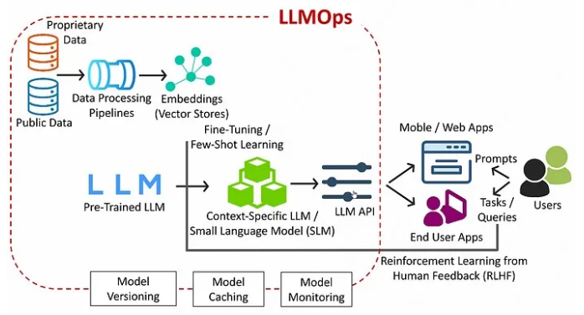
LLMOps: Overview
source: Palaniyappan, T.

Slide 20
LLM Implications for MLOps
Properties of LLMs | Implications for Production/ MLOps
Many kinds of models: General proprietary models behind paid APIs Open source models that vary from general to specific Custom models fine-tuned for specific applications | Development Process: Projects often develop incrementally, starting from existing, third-person or open source models and ending with custom fine-tuned models
Prompt engineering is part of development phase | Development Process: designing text templates for querying LLMs is an important part of LLM pipelines Artifacts: ML logic developed for pipelines may focus on prompt templates, agents, or chains instead of the model itself. ML artifacts packaged and prompted to production may frequently be these pipelines, rather than the models
LLMs can be given prompts with examples and context, or additional information to answer a query | Serving Infrastructure: When augmenting LLM queries with context, use vector databases to search for relevant context
LLMs range from GBs to 100’s GBs | Serving Infrastructure: Many LLMs may require GPUs for real-time model serving Cost/performance trade-offs: Techniques for reducing model size and computation may be required
LLMs are difficult to evaluate using traditional ML metrics | Human feedback: Human feedback must be incorporated directly into the MLOps process, both for testing and monitoring and for future fine-tuning
Source: Databricks

Slide 21
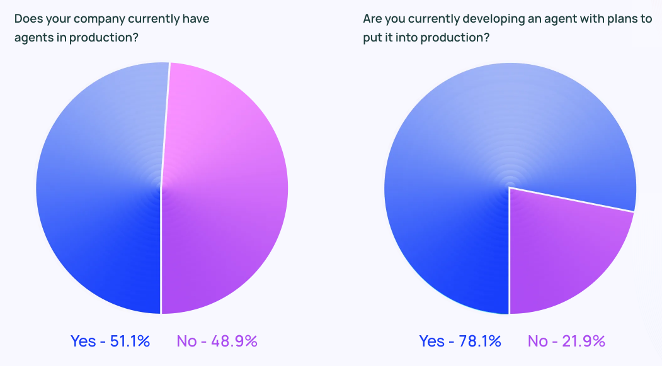
Agents in Production
Source: LangChain State of AI Agents 2024

Slide 22
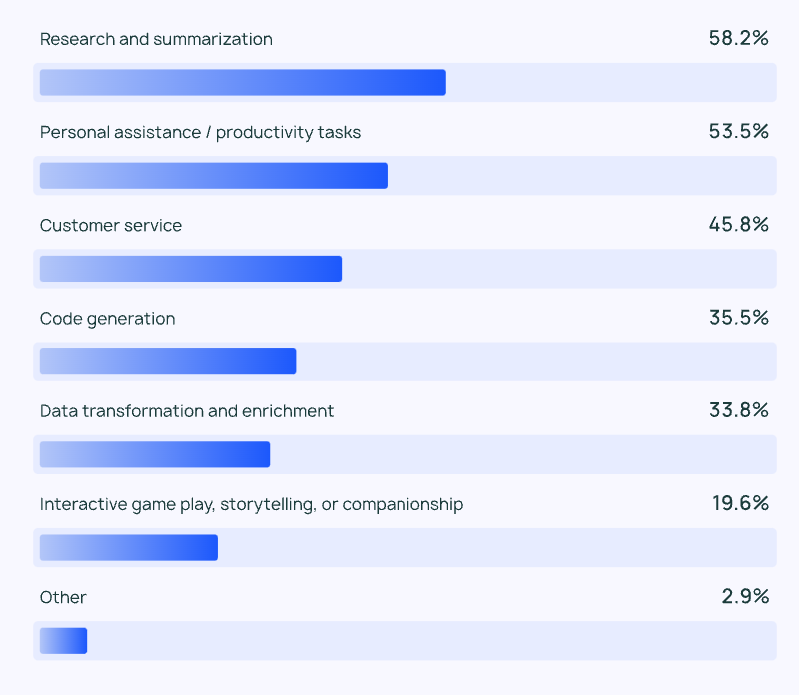
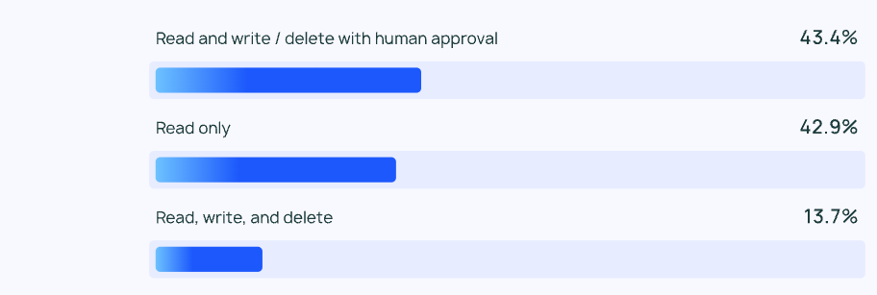
Agents in production
What tasks are agents best suited to perform today?
What kind of tool permissions does your agent have?
Source: LangChain State of AI Agents 2024

Slide 23
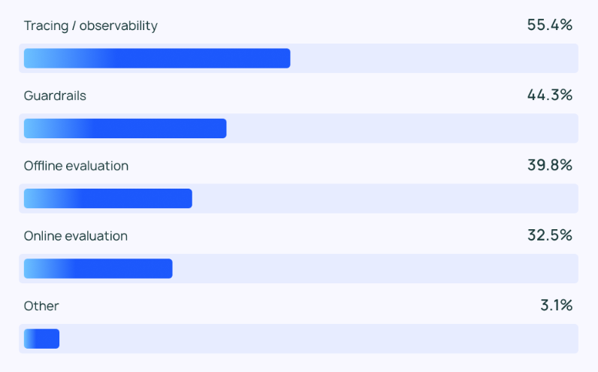
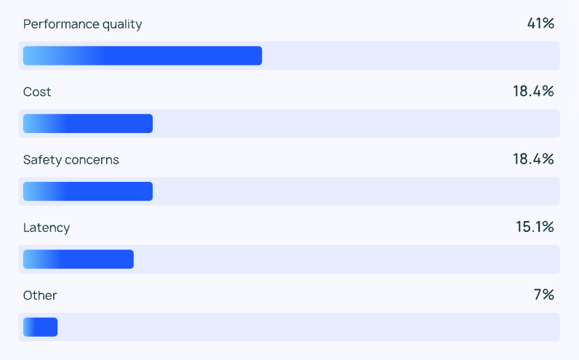
Agents in production
What kinds of controls do you have in place for agents?
What is your biggest limitation of putting more agents in production?
Source: LangChain State of AI Agents 2024

Slide 24
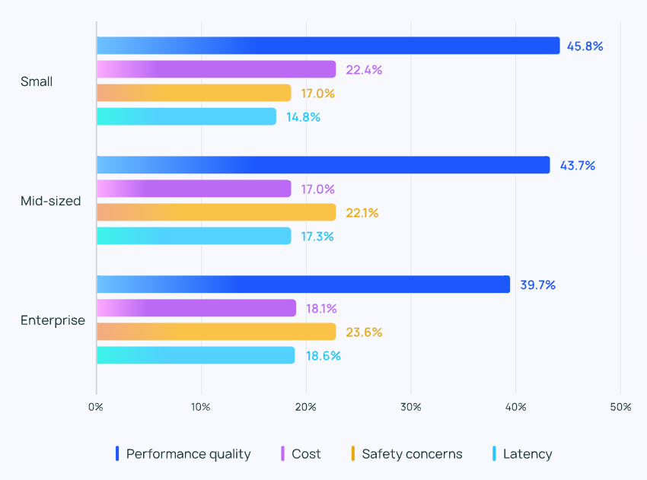
Agents in production
Barriers to deploying agents by company size
Source: LangChain State of AI Agents 2024

Slide 25
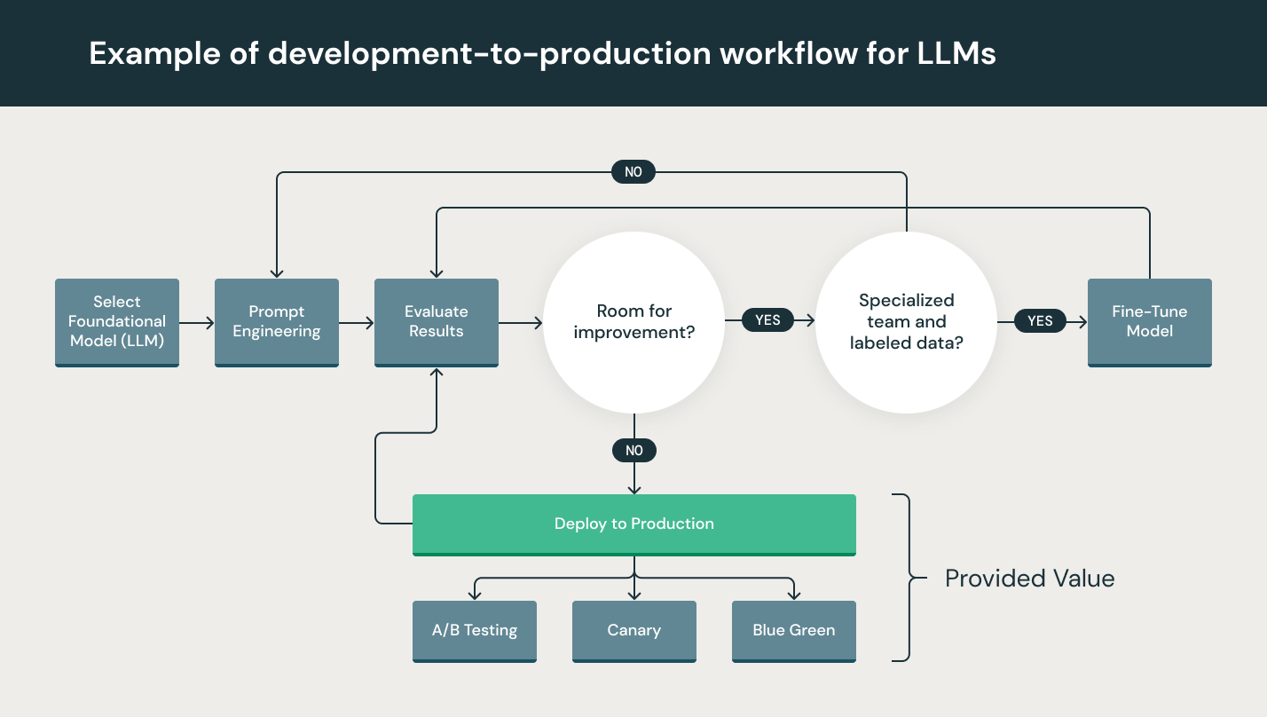
Dev-to-prod LLM workflow
source: Databricks

Slide 26
Control flow in LLM systems
Chains and agents

Slide 27
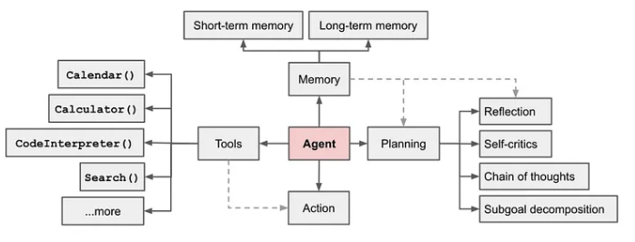
Control flow in llm systems
A set of steps before and/or after LLM calls (e.g., RAG)
Control flow steps are often called chains
Provide high-degree of reliability as the same set of steps runs with each chain invocation
When we want an LLM system to pick its own control flow → agent
The agent gives the LLM some degree of control over the sequence of steps in the application.
Source: Weng, Lilian, 203

Slide 28
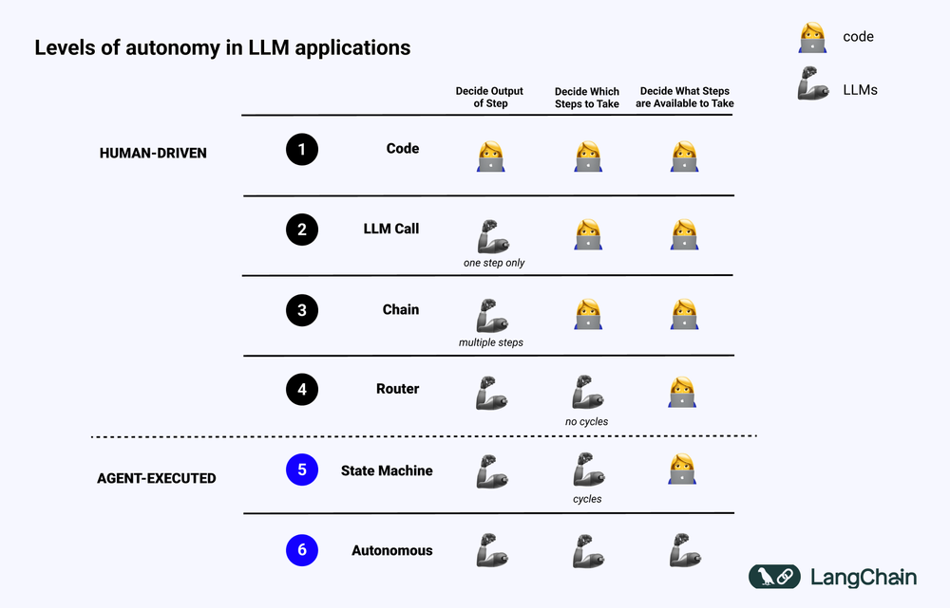
Agent architectures

Slide 29
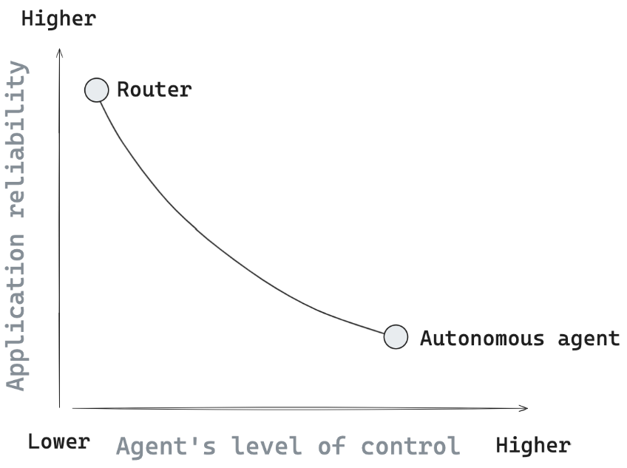
Agent architectures
Give LLM varying levels of control/ agency:
Router:
Allows an LLM to select a single step from a specified set of options
Fully-autonomous:
Long-running agent
Complete freedom to select any sequence of steps that it wants for a given problem
source: LangGraph

Slide 30
LangChain

Slide 31
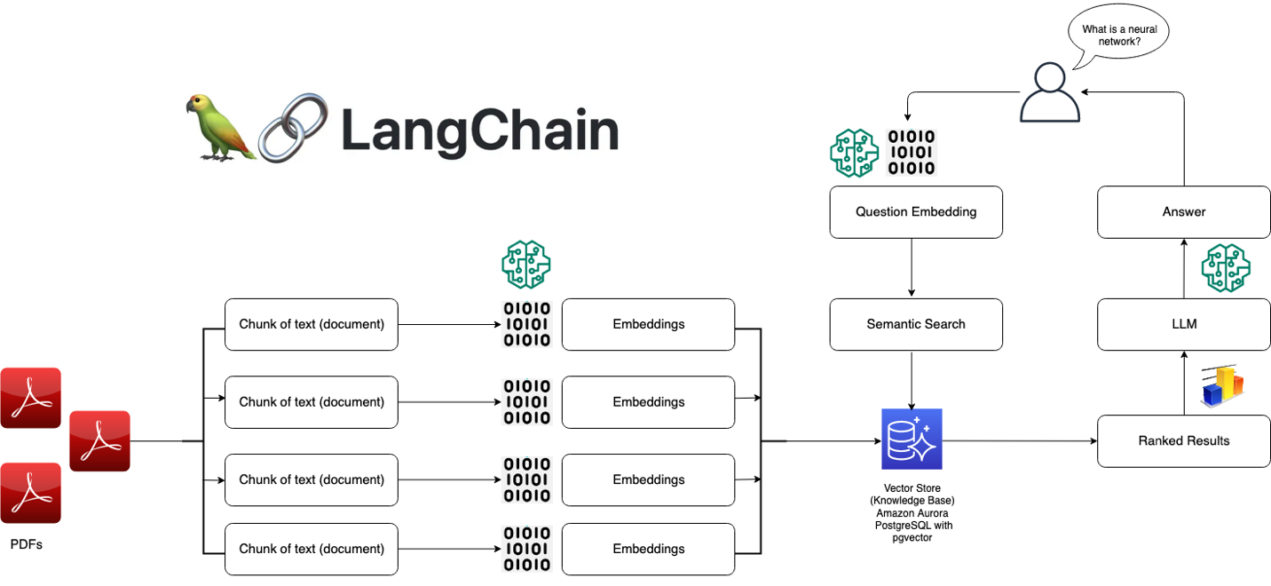
LangChain
Allow users to build custom agents by “chaining” together sequences of logic, reasoning, and tool calls to answer a query
Flexible abstractions and AI-first toolkit
source: AWS

Slide 32
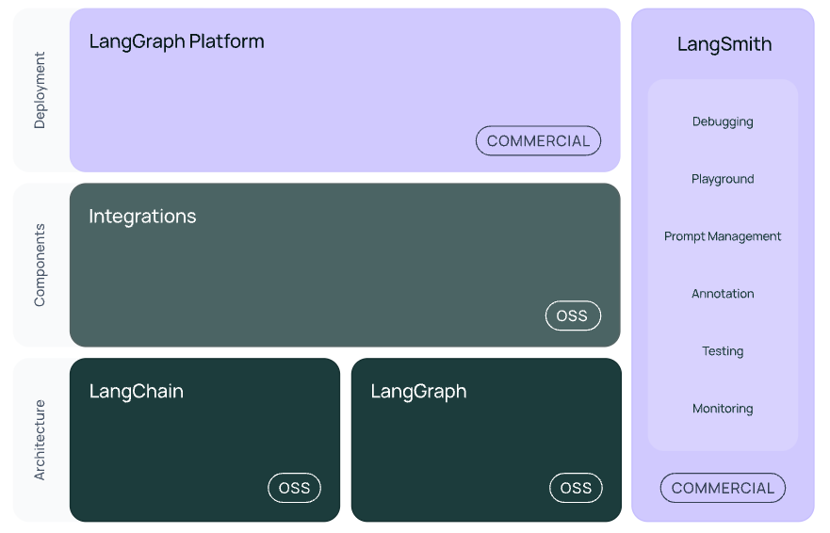
Langchain architecture
LangChain: contains chains and retrieval strategies that make up the cognitive architecture
LangChain-core: base abstractions for different components and ways to compose them together.
Chat models, vector stores, tools, etc.
Integration packages:
langchain-openai, langchain-anthropic, etc.
langchain-community: third-party integrations maintained by the community

Slide 33
Langchain components
LLM interface
Query LLMs from code (public and proprietary models)
Prompt templates
Agents
Compose and customize existing chains for complex applications
Agent prompts the model to decide the best sequence in response to a query
Retrieval modules
Architect RAG systems with numerous tools to transform, store, search, retrieve information
Memory
Simple memory (short term memory)
Complex memory (long term memory)
Callbacks

Slide 34
Langchain architecture
langgraph: extension of langchain aimed at building stateful, multi-actor applications by modeling steps as edges and nodes in a graph

Slide 35
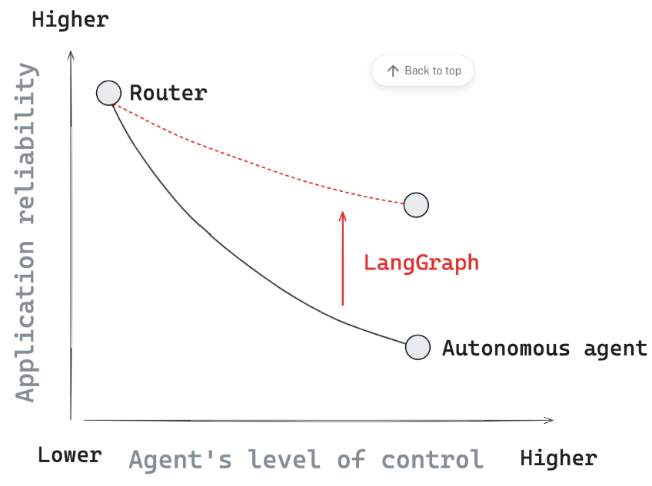
Langgraph
Helps preserve higher reliability as agents are given more control over an application

Slide 36
Langgraph principles
Controllability
Developer expresses the flow of the application as a set of nodes and edges
All nodes can access and modify common state (memory)
Persistence
Developer can persist graph state using short-term or long-term (e.g., database) memory
Human-in-the-loop:
Persistence layer enables several human-in-the-loop interaction patterns with agents
Pause, review state, edit state, approve a follow-up step
Streaming
Supports streaming, expose state to the user/ developer over the course of agent execution
Streaming of events (tool call being taken) as well as tokens that an LLM may emit

Slide 37
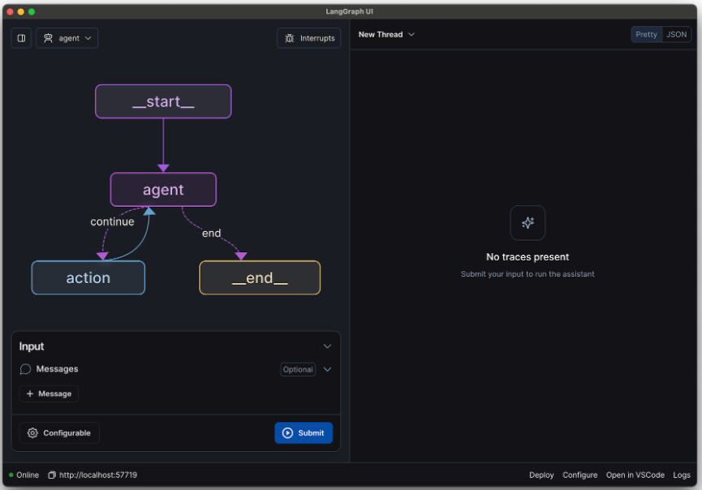
Langgraph studio
View and debug LangGraph applications

Slide 38
LLM Inferencing

Slide 39
Options for LLM inference
Triton Inference Server
Text Generation Inference
vLLM: Versatile Large Language Model
DeepSpeed MII
OpenLLM
MLC LLM: Machine learning compilation for Large Lanugage Models
Ray Serve
CTranslate2

Slide 40
Open Platform for Enterprise AI

Slide 41
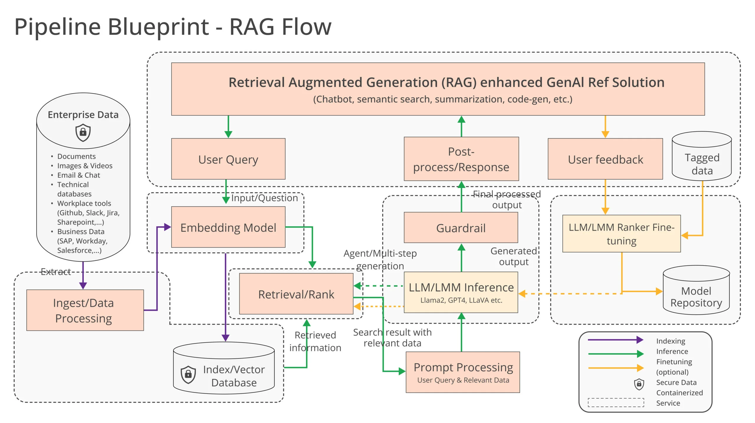
Opea: open platform for enterprise ai
Source: opea.dev

Slide 42
Kubeflow

Slide 43
Kubeflow
Pipelines
Kubeflow Pipelines (KFP)
Notebooks
Jupyter, R, VSCode
Dashboard
Kubeflow Central Dashboard
AutoML
Katib
Model Training
Kubeflow Training Operator
Model Serving
KServe
An ecosystem of Kubernetes based components for each stage in the AI/ML lifecycle
Open source tools and frameworks
Deployable anywhere you run Kubernetes

Slide 44
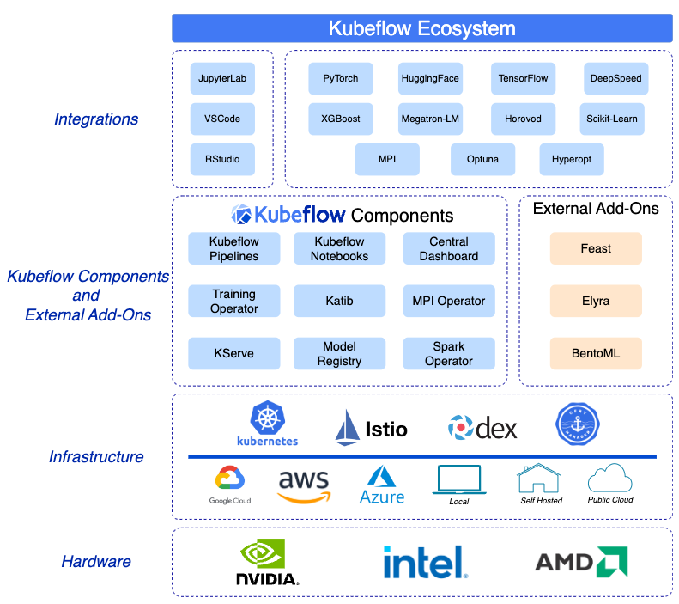
Kubeflow

Slide 45
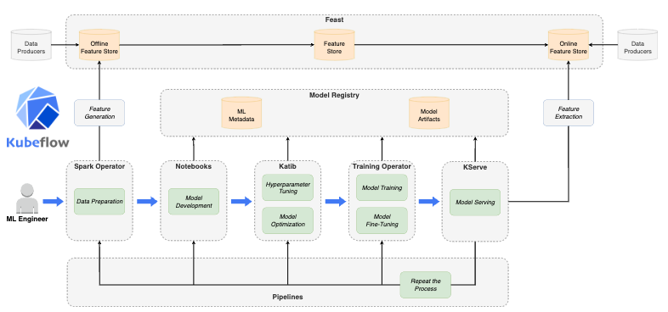
Kubeflow in the ML Lifecycle

Slide 46
Kubeflow external add-ons
KServe
Open-source serverless inferencing on Kubernetes
Feast
Open-source feature store
Elyra
Open-source tool to reduce model development life cycle complexities
JupyterLab extension that provides visual pipeline editor
Low-code creation of pipelines that can be executed with Kubeflow Pipelines

Slide 47
LAND ACKNOWLEDGEMENT STATEMENT
We respectfully acknowledge the University of Arizona is on the land and territories of Indigenous peoples. Today, Arizona is home to 22 federally-recognized tribes, with Tucson being home to the O’odham and the Yacqui. Committed to diversity and inclusion, the University strives to build sustainable relationships with sovereign Native Nations and Indigenous communities through education offerings, partnerships, and community service.

